Slide 1
Communication Through Gesture

Slide 2
Assisted By:
Anil Kumar
Swati Rao
Lalitha Gayathri
Bonafied work Done By:
Mudundi Siri
Anju Kanumuri
Bala Vegesna

Slide 3
Presentation Out Line
Introduction
What is nonverbal communication
Importance of nonverbal communication
Forms of nonverbal communication
Algorithm
Objectives Of Research

Slide 4
Introduction
A gesture is a form of non-verbal communication or non-vocal communication in which visible bodily actions communicate particular messages, either in place of, or in conjunction with, speech. Gestures include movement of the hands, face, or other parts of the body.

Slide 5
Introduction About AI
This AI and Deep learning course offers practical and task-oriented training using Tensor Flow and keras on Python platform. Recent developments in Deep learning have been nothing short of a revolution and have enabled some of the most exciting and powerful applications in the field of Artificial Intelligence.

Slide 6
What is non verbal communication?
Non verbal communication=Communication without words
Non verbal communication is a process of communication through sending and receiving wordless messages.

Slide 7
Importance Of Nonverbal Communication
Verbal and Nonverbal communication plays an important role in how people interract with each other.People are using 35% verbal communication and 65% nonverbal communication in daily life.
“The most important thing in communication is to hear what isnt being said.”
-Peter F.Drucker

Slide 8
Forms Of Nonverbal Communication
Eye contact
Facial expressions
Posture
Haptics or Touch
Gestures
Personal space

Slide 9


Slide 10
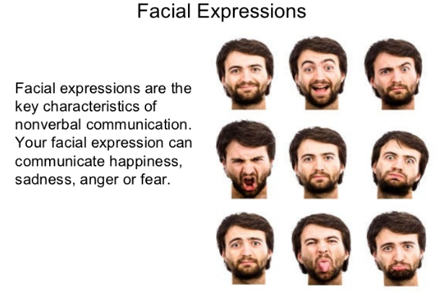

Slide 11
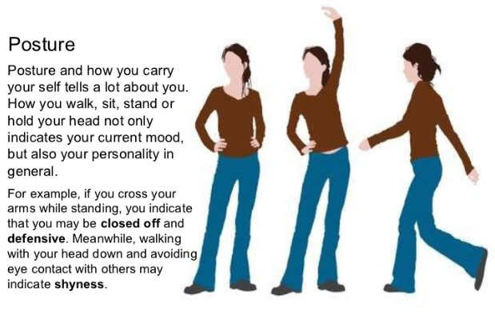

Slide 12
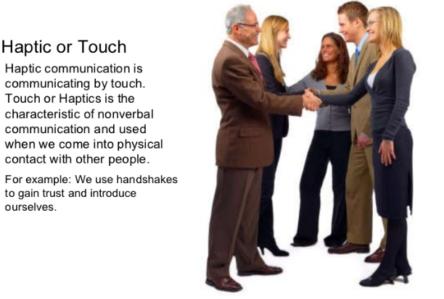

Slide 13
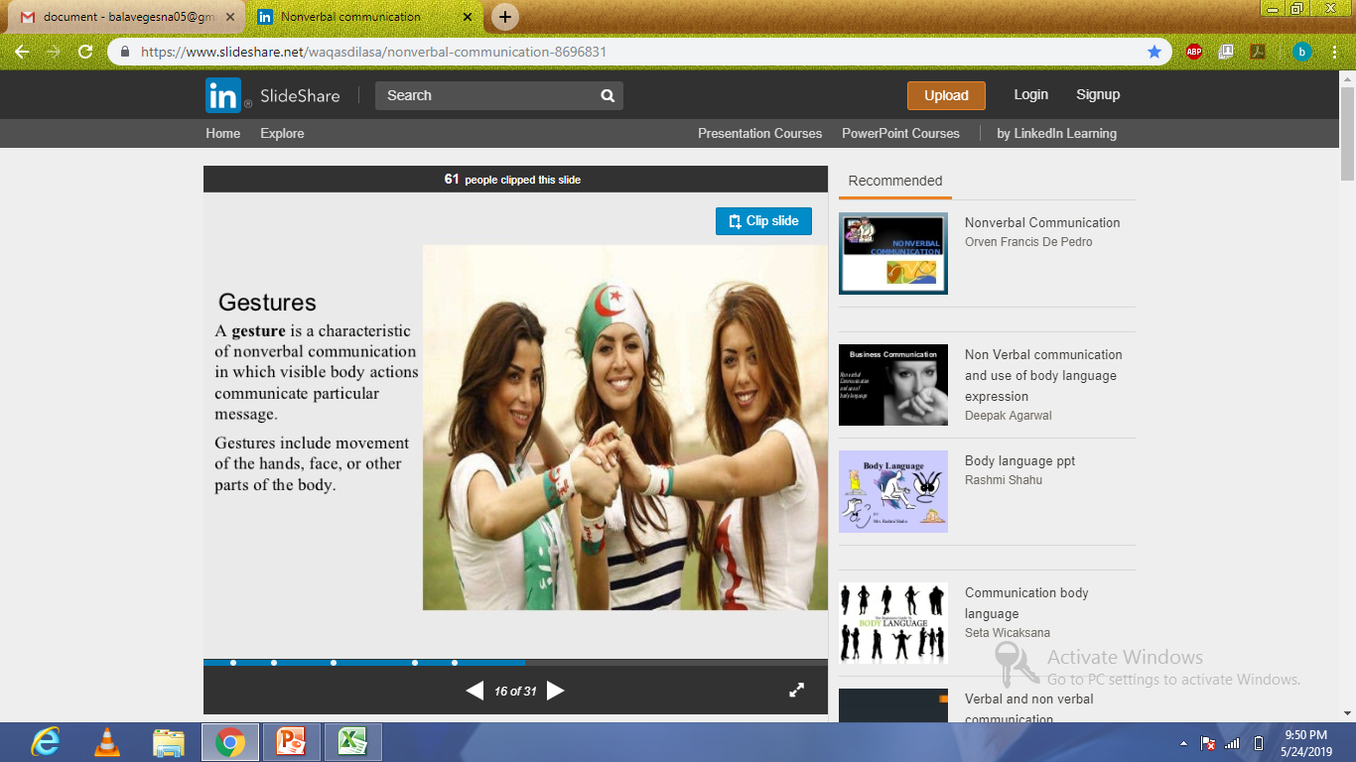

Slide 14
Algorithm
Convolutional Neural Network(CNN)
So basically we are using CNN process in our project.CNN is a specific type of artificial neural network that uses perceptions, a machine learning unit algorithm, for supervised learning, to analyze data.CNN supply to image processing, natural language processing and other kinds of cognitive tasks.

Slide 15
Data Analysis
DATA DIVISION | NO.OF FOLDERS | NO.OF IMAGES
Test data | 10 | 400
Train data | 10 | 1600
Total no.of Images | - | 2000

Slide 16
Keras
Keras is an open-source neural-network library written in Python. It is capable of running on top of TensorFlow. Designed to enable fast experimentation with deep neural networks, it focuses on being user-friendly, modular, and extensible

Slide 17
Python gui-Tkinter
It is a standard Python interface to the Tk GUI toolkit shipped with Python. Python with tkinter outputs the fastest and easiest way to create the GUI applications. Creating a GUI using tkinter is an easy task.

Slide 18
Objectives Of Research
Here in this research we focused mainly on the action given by the user to communicate with the machine,also it helps the dumb people to develop in the society.

Slide 19
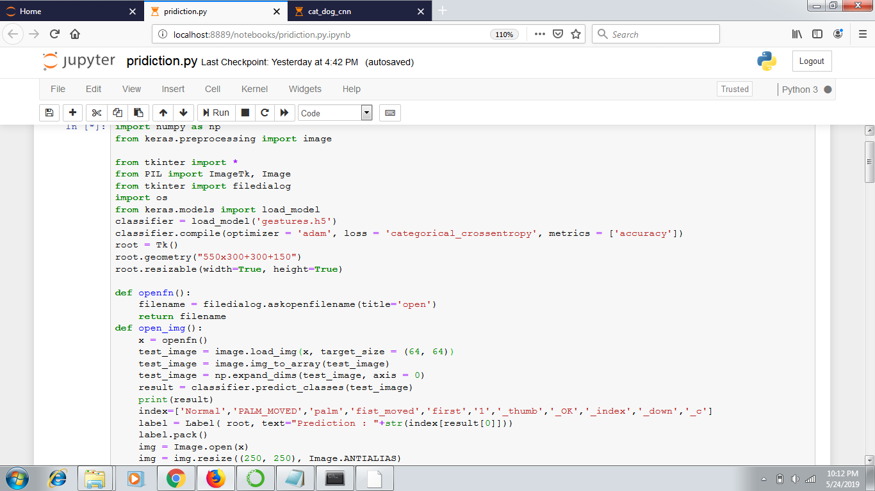
Prediction Code:

Slide 20
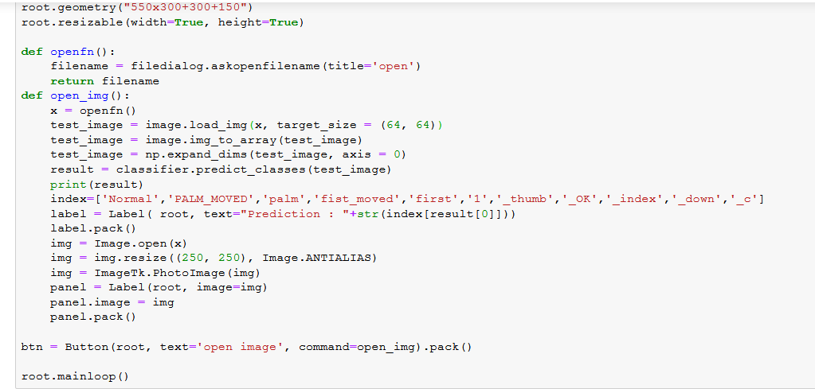
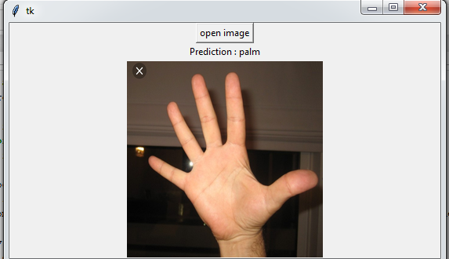

Slide 21
Conclusion:
We have introduced gestures in this topic of language evolution by exploring the different types of gestures .In both infants and animals, gestures are a way of learning how to communicate. Infants imitate to match what they see to what they do, while animals imitate as a form of social learning – by imprinting behaviors from an adult or peer to a child.

Slide 22
